Slide 1
Healthcare Data Breaches
Srinivas Pallapu 11604461

Slide 2
Introduction
Healthcare is one of the most critical sectors with involves a lot of personal and sensitive information making it a primary target for cyber-attacks. Healthcare data breaches are believed to be a significant threat to the privacy and security of individuals' information
In the United States, the Department of Health and Human Services Office for Civil Rights documents such incidents.

Slide 3
Data Collection
The dataset used in this project is titled “Healthcare Data Breaches” and contains 866 records of different data breaches in the healthcare domain.
The data was found in U.S. Department of Health and Human Services Office for Civil Rights.
The dataset contain 866 data records about healthcare breaches over the last three years. It has 9 columns.

Slide 4
Data Dictionary
1 . Name of covered entity (string): The name of the covered entity, i.e., the organization or entity responsible for protecting the healthcare data.
2. state (string): The U.S. state where the data breach occurred.
3. Covered entity type (string): The type of covered entity affected by the breach (e.g., healthcare provider, health plan, business associate).
4. Individuals affected (integer): The number of individuals whose data was affected or compromised in the breach.
5. Breach submission date (date): The date when the breach was reported or submitted.
6. Type of breach (string): The nature or type of the data breach (e.g., unauthorized access, hacking, loss of physical records).
7. Location of breached information (string): Details about where the breached information was stored or the specific system affected.
8. Business associate present (string): Indicates whether a business associate was involved or present in the breach. It could be a "yes" or "no" value.
9. Web description (string): A textual description providing additional information about the breach, potentially including the circumstances or impact.

Slide 5
Data Preprocessing
The data collected was good enough to proceed without any significant data preprocessing.
Only 1 column of the web description which was empty was removed.
4 missing records in the State column was replaced with Unknown.

Slide 6
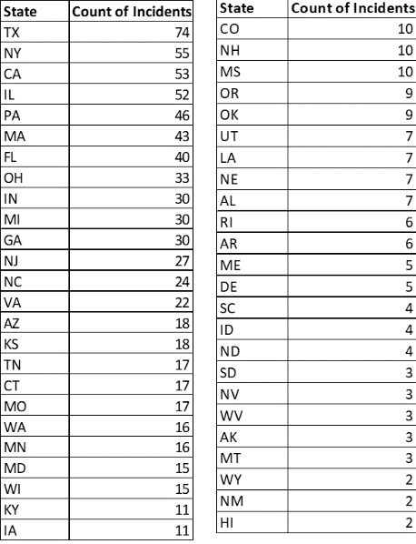
Exploratory Data Analysis-EDA
Number of Incidents in different states.
Texas (TX) is leading in the list with 74 incidents, next in the list is New York with 55 incidents, California with 53 incidents, and Illinois with 52 incidents. These 4 states make up a majority of 27% of all the incidents across the United States.
Hawaii, New Mexico, Wyoming, and Montana are some of the states with fewer data breach incidents (less than 5).
This difference in the count of incidents can be due to different densities of healthcare providers, varying cybersecurity measures, population, and crime rates in the states.

Slide 7
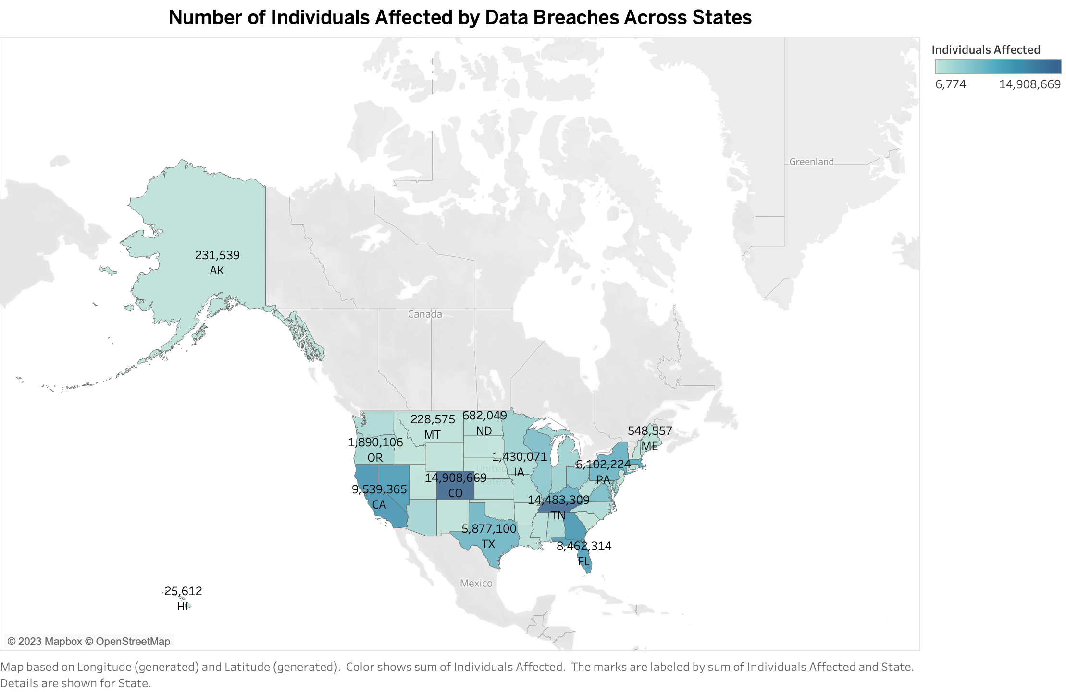
Does any particular geographical location like States have a significant impact on the number of affected individuals by data breaches in the healthcare sector?
Colorado and Tennessee are the states which have the most affected individuals due to healthcare breaches.

Slide 8
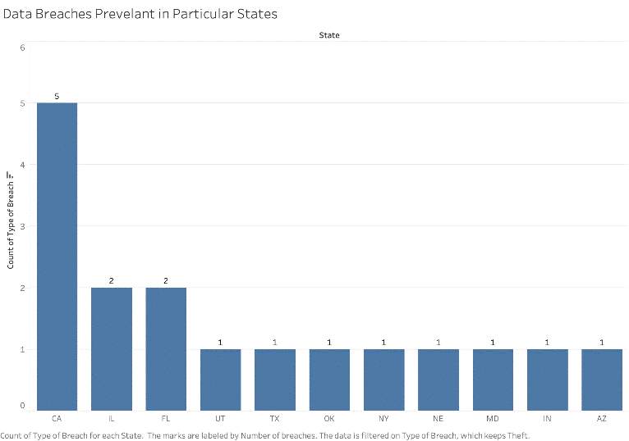
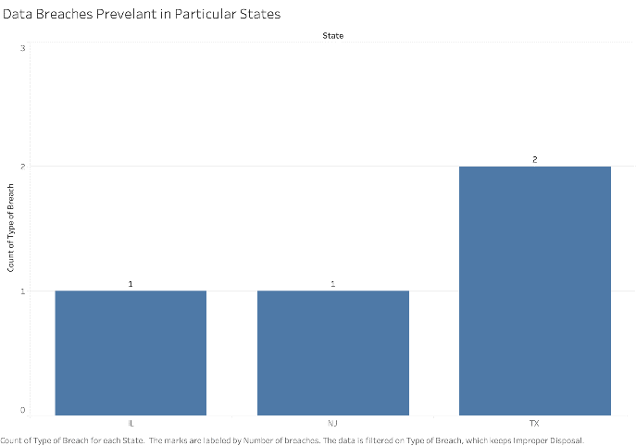
2. Are there any specific types of data breaches more prevalent in some of the states only?
Improper Disposal was found particularly in the state of Texas and 1 in New Jersey and Illinois.
Loss due to negligence was 3 incidents in Illinois, and 1 each in New York and New Hampshire
Breaches due to threat incidents are common in the state of California.
Hacking and IT-related issues are prevalent in all the states of USA in any healthcare data breach.

Slide 9
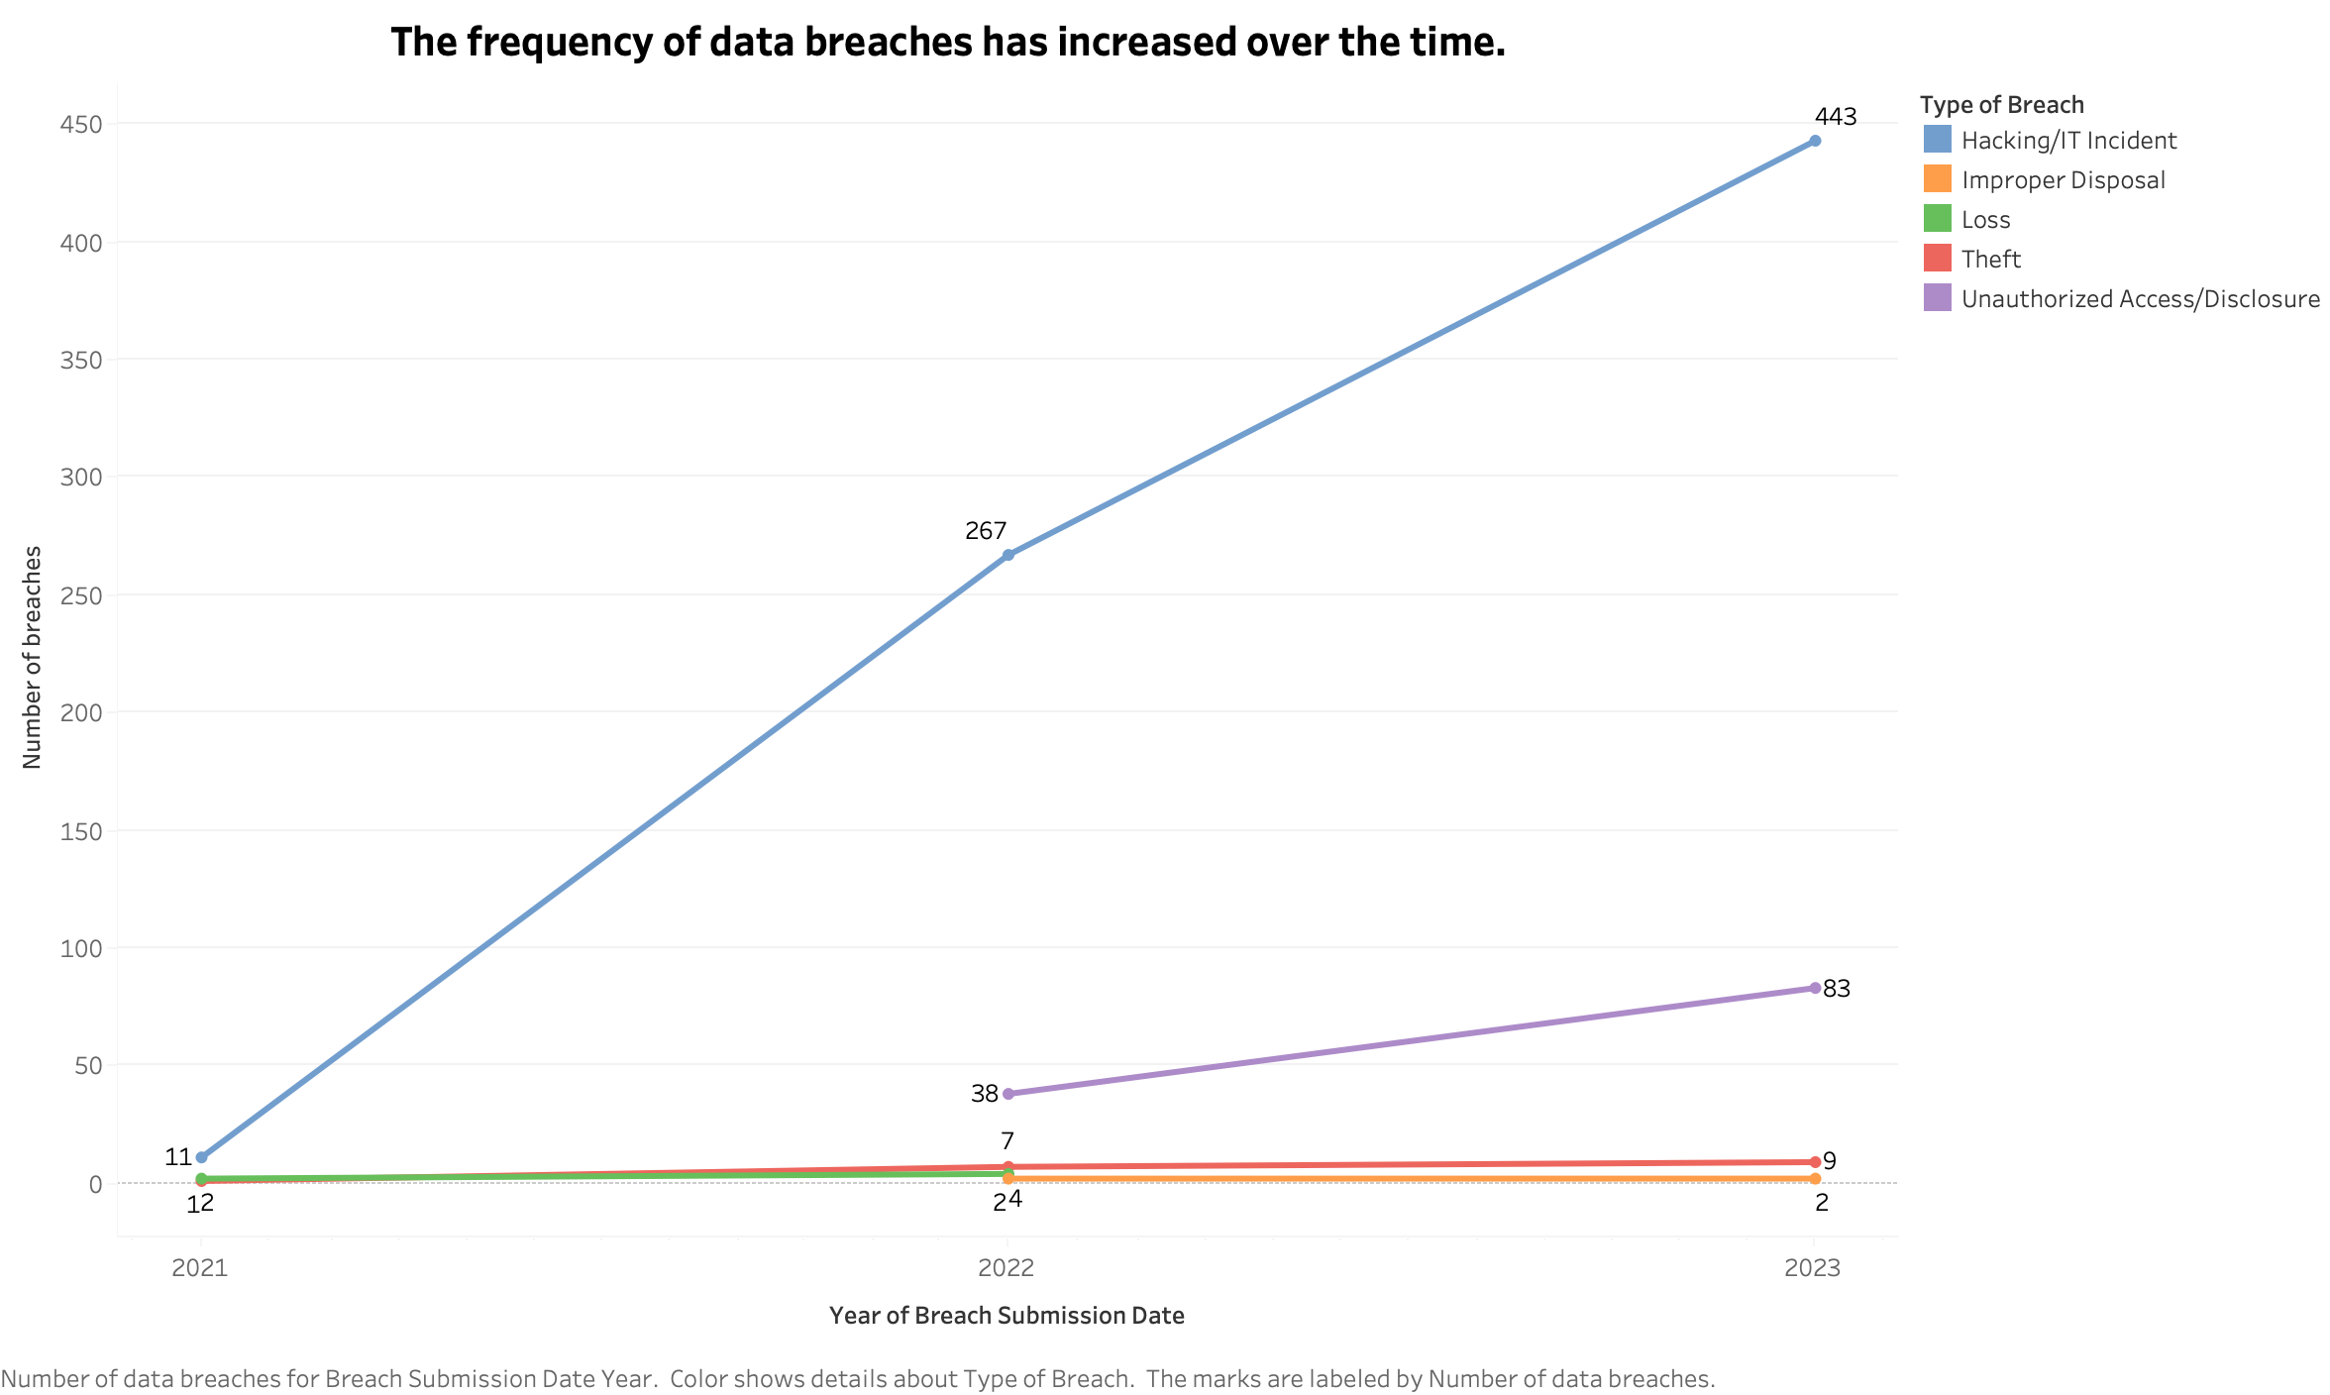
3. Has there been a significant increase in the frequency of healthcare data breaches over the last 3 years i.e. from 2021 to 2023?
From the below line chart, there has been a significant increase in the number of hacking or IT-related incidents across the country. It increased from 11 incidents in 2021 to 267 incidents in 2022 and further almost doubled to 443 incidents in the year of 2023.
Unauthorized access related incidents are newer in comparison to the other breaches. Maybe because of improved security measures that are now able to identify such elements of unauthorized access in different organizations.

Slide 10
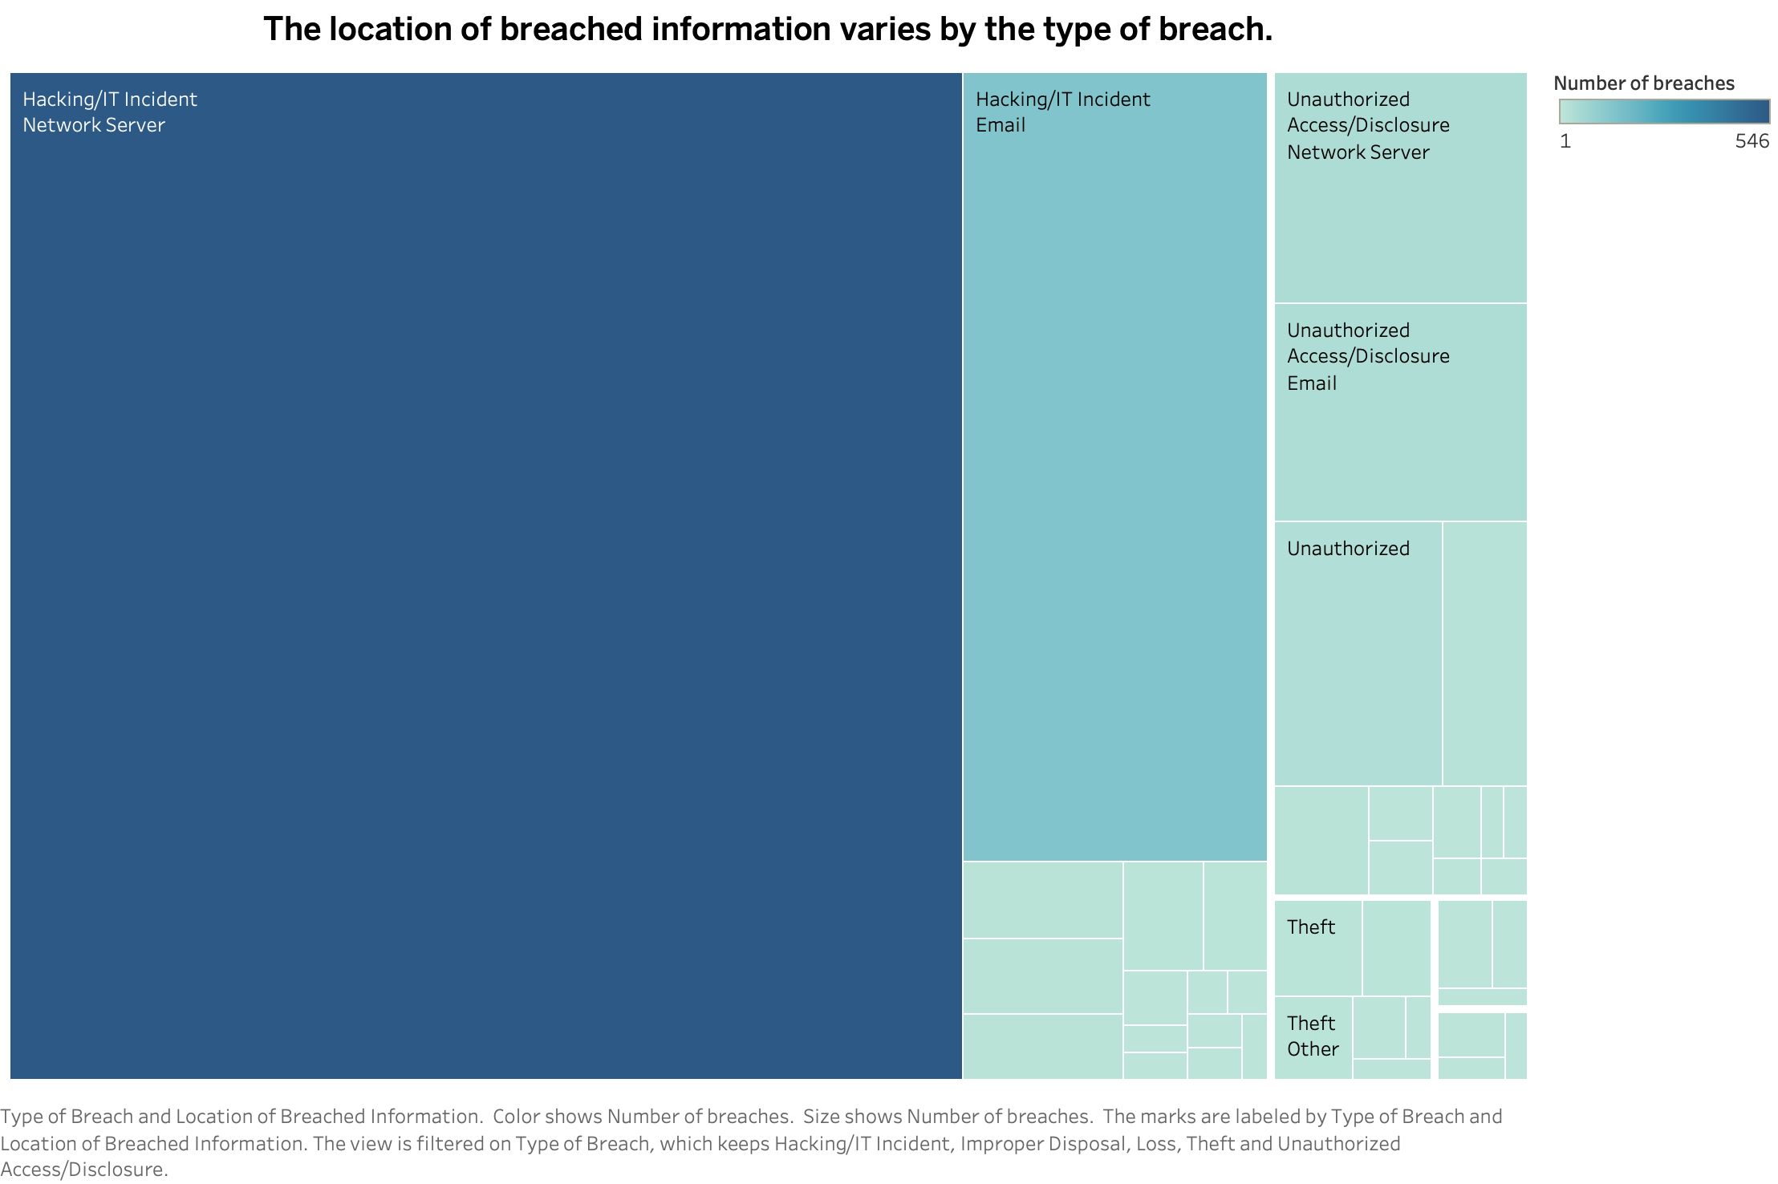
4. Do certain types of healthcare data breaches exhibit a correlation based on the location of the information storage that was breached?
The tree map clearly shows the most common target of the attacks online are the network servers that store the critical health data records of the patients. This number was equal to 546 in the number of breaches out of 867 breaches in this dataset over the last 3 years. This accounts for about 65% of the total data breaches. The second target areas is the Email in the hacking incident that comprises of 137 data breaches.

Slide 11
Conclusion
Based on this project analysis, we can say that cyber attacks are huge threats in the healthcare related industry and significant steps are required to prevent loss of sensitive information.
The most common data breach is the hacking and IT-related incidents. Showing clear indication that proper IT and security measures need to be implemented in organization like hospitals and other healthcare centers.
States should make policies and provide special care and resources in this process.

Slide 12
Thank You

